Slide 1
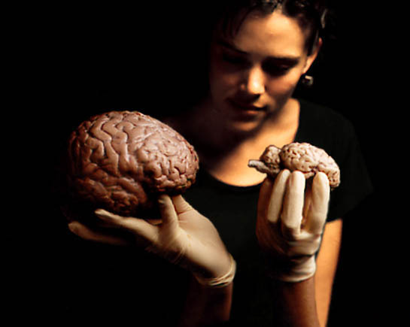
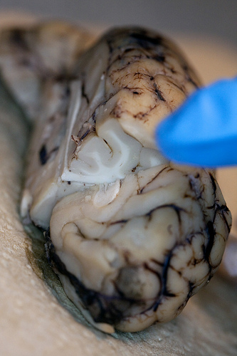
Neurological Disorders Lesson 1.2
How does brain structure impact its function?

Slide 2
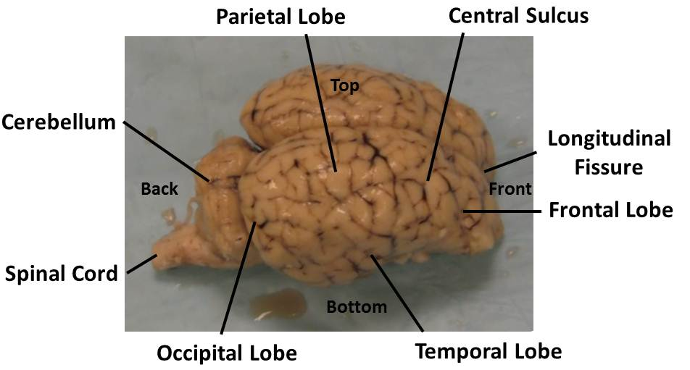
Right Hemisphere of Sheep’s Brain

Slide 3
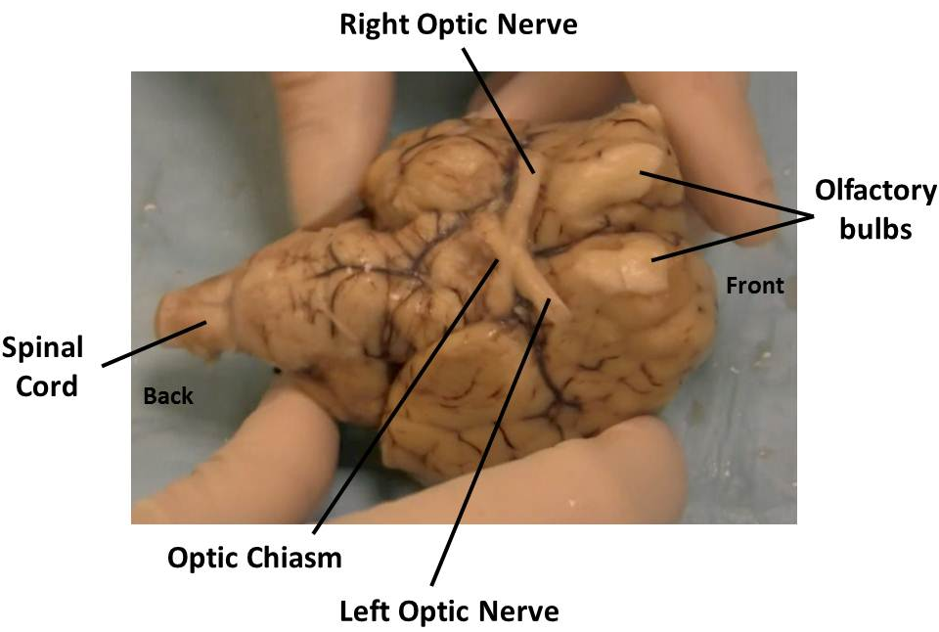
Underside of Sheep’s Brain

Slide 4
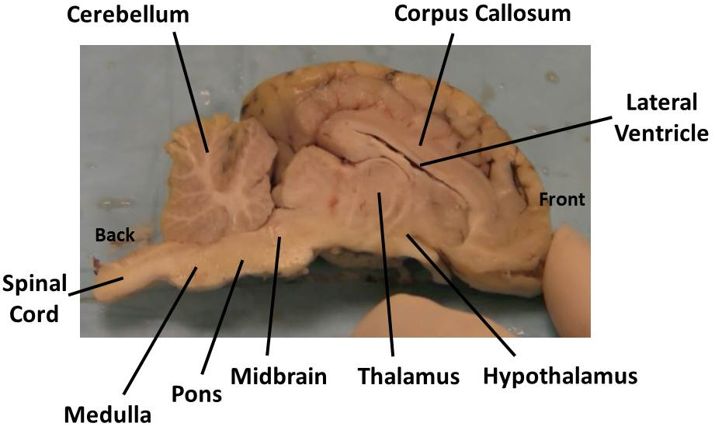
Sagittal Cut of Sheep’s Brain
Sagittal Plane
Back
Front

Slide 5
Coronal Cut of Sheep’s Brain
Coronal Plane
Back
Front

Slide 6
Brain video

Slide 7
Bozeman Brain Video

